Slide 1
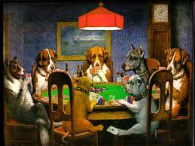
Introduction to Game Theory
Economics 171

Slide 2
Course requirements
Class website Go to economics department home page. Under Links, find Class pages, then click on Econ 171
Textbook: Games, Strategies, and Decision Making by Joseph E. Harrington, Jr.
Clicker available at campus bookstore i>clicker Register your clicker at www.i>clicker.com/registration

Slide 3
Office Hours
Location: 2052 North Hall
Times: Wednesday, 2:00-3:30 and by appointment

Slide 4
Is this the course for you?
Regular assigned reading and homework.
You are expected to do assigned reading before you come to class. Clicker questions will check on this.
Strict grading.
Challenging, but I hope interesting.

Slide 5
Cheating
Sorry to have to mention this, but it has been a problem recently.
If I catch you cheating, for example, by copying homework or exams, you will fail the course and I will turn the case over to university authorities.
University ruling: “Being copied counts as cheating, just as much cheating as copying.”

Slide 6
Assignments: See class website
Week 1 January 5 and 7. Readings: Harrington: Chapters 1 and 2. Complete readings by Thursday, Jan 7. As you read, do the "Check Your Understanding Exercises." Answers to these are found in the back of the book. You do not need to turn these in, but you should do them. Homework: Due January 7: problems 1, 3, 8 and 9.

Slide 7
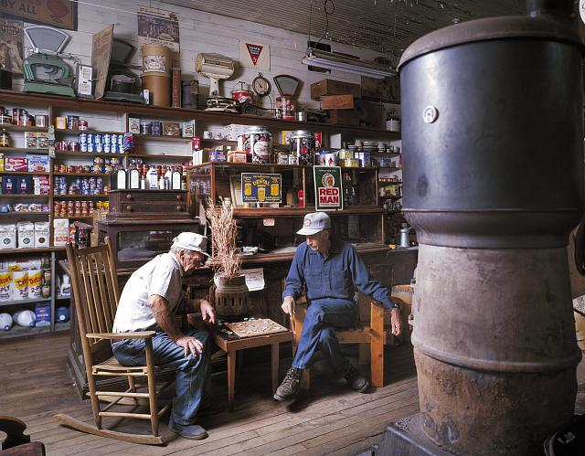
Checkers, An Example:

Slide 8
Extensive game: Perfect Information
Players take turns making moves.
Each player knows the rules of the game and the payoffs of each final outcome to all players.
Whenever it is somebody’s turn, he or she knows everything that has happened so far.

Slide 9
Example: Incumbent and Challenger
Incumbent firm holds a monopoly
Challenger considers entering and sharing the market.
If challenger enters, incumbent decides whether to fight him or share the market.

Slide 10
Extensive Form Games with Perfect Information Example: The Entry Game
Challenger
Challenge
Stay out
Incumbent
0 Challenger’s payoff
1 Incumbent’s payoff
Give in
Fight
1
0
-1 -1
Challenger’s payoff
Incumbent’s payoff

Slide 11
Vocabulary for Extensive form games
Decision Tree
Decision Node-Specifies whose turn
Branches-Options
Terminal Node—End of play
Payoffs—For each player at each terminal node.
Strategy—Specifies what will you do at each decision node where it is your turn

Slide 12
What are strategies in entry game?
For Challenger
Challenge
Stay Out
For Incumbent
Give in if challenged
Fight if challenged

Slide 13
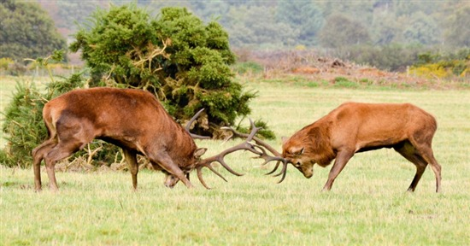
A possible outcome

Slide 14
A Kidnapping Game
Kidnapping is risky and dangerous, but could be profitable.
Will victim’s friends pay a ransom?
If they do pay a ransom, why should you free
the victim?
If they don’t expect you to free the victim, would you expect friends of victim to pay ransom?

Slide 15
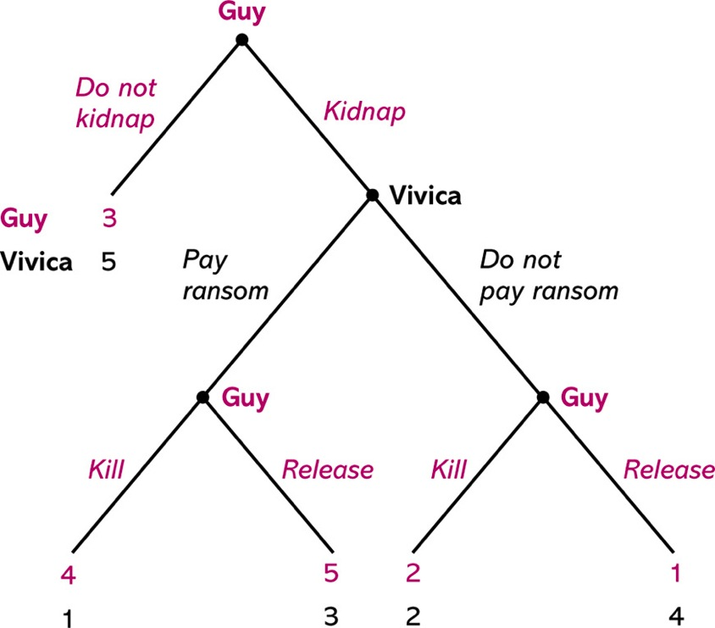
Kidnapping Game

Slide 16
Vocabulary for Extensive form games
Decision Tree
Decision Node-Specifies whose turn
Branches-Options
Terminal Node—End of play
Payoffs—For each person at each terminal node.
Strategy—What will you do at each decision node where it is your turn

Slide 17
What are the strategies?
Vivica has 1 decision node and two strategies
Pay Ransom
Don’t Pay Ransom
Guy has three decision nodes. A strategy specifies what he will do at each node.
Example strategy:
Kidnap, Kill if ransom, Kill if no ransom
Kidnap, Don’t kill if ransom, Kill if no ransom
Kidnap, Kill if ransom, Don’t kill if no ransom
Kidnap, Don’t kill, Don’t Kill
Don’t kidnap, Kill, Kill
Don’t kidnap, Don’t kill, kill
Etc.

Slide 18
Extensive form: Imperfect Information
When you move, you don’t always know what move the other guy has made.
Often motivated by simultaneous move games.

Slide 19
Example: Copy cat game (matching pennies)
Little brother wants to do everything that big brother does.
Big brother is embarrassed by this. Wants to do opposite of what little brother does.

Slide 20
Complete Information: Big brother moves first
Big Brother
H
T
Little Brother
Little Brother
H
T
H
T
0
1
1
0
1
0
0
1

Slide 21
What would happen?
What would you predict if big brother moves first?
What would you predict if little brother moves first?

Slide 22
Incomplete Information: Simultaneous move
Big Brother
H
T
Information set:
Little Brother
Little Brother
H
T
H
T
0
1
1
0
1
0
0
1

Slide 23
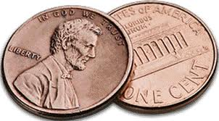

Slide 24
Clicker Trial Run
Do you have a working clicker?
No, I am just pressing the button on my ballpoint

Slide 25
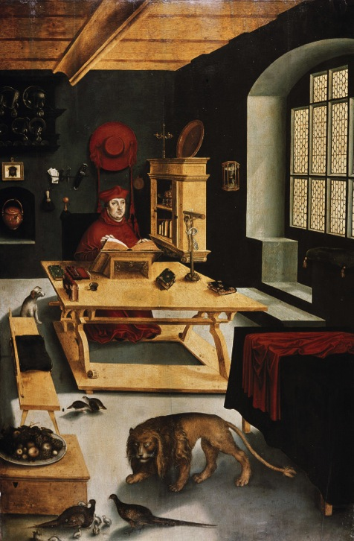
See you on Thursday…
Don’t forget your homework.
(or your clicker.)

