Slide 1
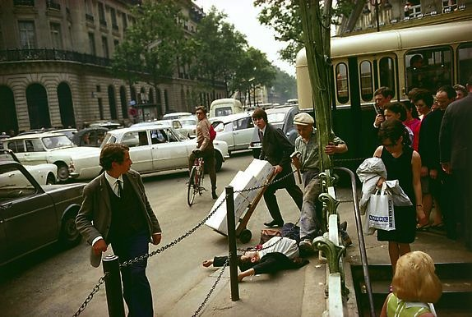
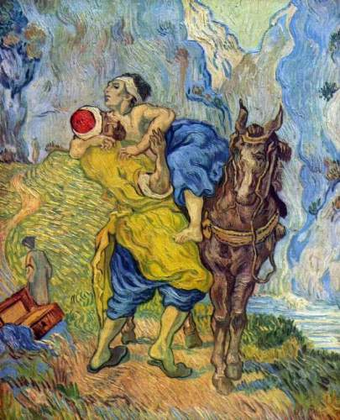
Tales of Competing Altruists
As told by…
Ted Bergstrom, Rod Garrett, and Greg Leo
UC Santa Barbara

Slide 2
A Dark Tale from the Big Apple

Slide 3
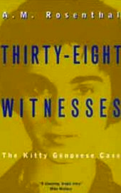
The Kitty Genovese Case
In 1964, as she returned home from work late at night, Kitty Genovese was stabbed and assaulted near her apartment building in New York City.
“For more than half an hour thirty-eight respectable, law-abiding citizens in
Queens watched a killer stalk and stab a woman in three separate attacks”---NY Times Story
Pundits found this “emblematic of the callousness or apathy of life in big cities, particularly New York.”

Slide 4
A Defense of New Yorkers?
Sociologists, John Darley and Bibb Latane suggested a “diffusion of responsibility” hypothesis. City dwellers may not be “callous.” They know many are present and assume someone else will act.
They showed this effect in lab experiments.
Andreas Diekmann produced a simple game theoretic model which he called the “Volunteer’s Dilemma”
N-player simultaneous move game: Strategies Act or Not.
All who act pay C. If at least one acts, those who acted get B-C.. Those who didn’t act get B. If nobody acts, all get 0.
In symmetric mixed strategy Nash equilibrium, as N increases, it less likely that any one person calls. In fact, it is more likely that nobody calls.

Slide 5
A larger question
In Volunteer’s Dilemma game, despite
technical increasing returns to scale, people are worse off belonging to larger groups than to smaller groups.
Is this generally true?
If so, what does it predict about group formation?

Slide 6
Special Features of Volunteers’ Dilemma Model
The Information and Duplication Problem
There is no feasible way to realize returns to scale Although action of only one person needed, there is no way for others to know if someone else has acted.
Assumed Symmetry of Costs and Sympathies

Slide 7
Coordinated Volunteers’ Dilemma
Sometimes it is possible to organize volunteer work by asking for volunteers, then randomly select one to do the job.
This improves on Volunteers’ Dilemma but it is still true that the probability that nobody takes action increases with size of group.
Weesie and Franzen 1998
Bergstrom 2012

Slide 8
First to offer does the job
Subway passenger offers a seat to old person.
Rescuing a drowning swimmer.
Audience member opens a window in a stuffy auditorium.
Passing traveler rescues a stranded motorist.

Slide 9
Differing Costs and Sympathies
Volunteers’ Dilemma played by strangers
Players know their own costs and benefits, but only know the distribution function of cost-benefit ratios of others.
There is a symmetric equilibrium in pure strategies.
Act if cost/benefit ratio is below some threshold.

Slide 10
Coordinated Volunteers’ Dilemmas
If preferences differ, as number of players increases, action is more likely to be taken earlier.
Ballroom Dancing and Dragon-Slaying --Bliss and Nalebuff, 1984
Incomplete Information and Timing in Volunteers’ Dilemma– Weesie, 1994
Good Samaritan and the Road to Jericho—Bergstrom, 2013

Slide 11
A Brighter Tale

Slide 12
Stem cell donations
Bone marrow or stem cell transplants dramatically improve survival prospects of people with leukemia and other blood diseases.
For transplants to work, donor must be a genetic match for recipient.
Only 30% of patients have matching sibling. Others must seek match in population at large.
Notes:
Bone marrow transplant is short for …

Slide 13
The Bone Marrow Registry
Six million Americans and 20 million people worldwide have offered to donate stem cells or bone marrow to save the life of a complete stranger.
Bone marrow extraction is traditional method.
Requires anesthesia and big needles.
Newer method is stem cell extraction. Requires prior steroid injections, blood aphoresis.
About as unpleasant as a case of the flu.

Slide 14
Bone Marrow registry
Registrants promise to donate bone marrow or stem cells to any needy person if called upon to do so. (not a binding contract)
Registry collects saliva sample, does a DNA test for HLA type and records registrant’s contact information.
Notes:
There is an episode of the HBO show "Curb Your Enthusiasm" in which the comedian Richard Lewis needs a kidney transplant and Larry David (the creator of Seinfeld) vows to donate his, thinking he won't be a match. Larry is horrified to learn he actually is a match, and goes to ridiculous lengths to get out of it by trying to find Richard a "better" match. Larry was clearly a pledge donor.
Answers to the first question will be crucial given a negative answer to the second.

Slide 15
Why such a large registry?
There are about 20 million distinct types.
Probability that two Americans of European descent are a match is 1/11,000.
About half the Caucasian population are in types of frequency smaller than 1/100,000.
About 20 per cent are in types of frequency smaller than 1/1,000,000.
African-American types are even more diffuse.

Slide 16
Competing altruists?
Only about 1% of those who join registry will ever be asked to donate.
Most people are of relatively common types.
If you are asked, the probability is about .9 that there was someone else in the registry of the same type who also could have been asked.

Slide 17
Registry appeal:
They do not highlight probability that you may be the only one in the registry who can save a life.
They say: If you register, you have a chance to “Be the Match that saves a life.”

Slide 18
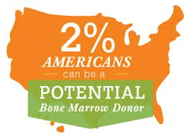

Slide 19
Detecting Altruists’ Motivations by Experiment
Usual game theoretic experiments
Try to induce known payoffs for subjects
Then see if subjects find their way to Nash Equilibrium assuming their motivations are the induced ones
Not us. We want to find out motivations.
We believe subjects bring to the lab the rules of behavior that they normally use in life and try to apply them in the proposed situation.
We want to find out what motivations they bring to the lab.

Slide 20
Possible motivations
Egoist
Sympathetic consequentialist.
“Do the right thing” ethic (deontologist)
Impact philanthropist (wants to “Be the one.”)

Slide 21
First-to-help experiment
A group of $N$ people. All but one are given $10, the other gets $0.
All are told what happened and that anyone can give up $1 so that the unlucky person will get $9 instead of $0.
The $1 will be taken from the first person to offer help.
In separate treatments, $N$ ranges from 2 to 7.
Donors and recipients are anonymous to each other.

Slide 22
Implementation
Subjects sit at a computer screen and the game is explained.
A time clock is shown and they can offer to help at any time during a 30 second interval.
They can also press buttons
First Possible Moment
Last Possible Moment
Not at all

Slide 23
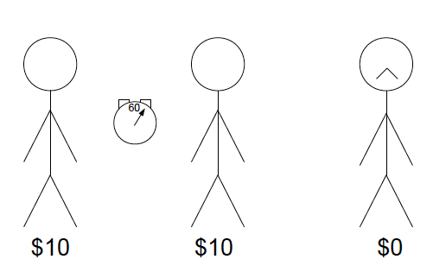
The setup when N=3

Slide 24
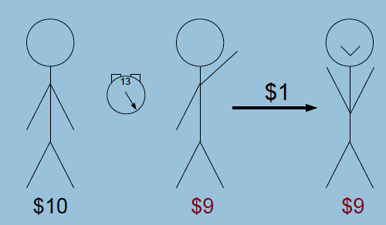
First to offer

Slide 25
What we expect
Egoists will not give.
Sympathetic consequentialists will give at last possible moment. (They want person to be helped, but would rather someone else did it.)
Impact philanthropists and some deontologists would choose first possible moment.

Slide 26
When they volunteer
100%
First
80%
Other
60%
Last
40%
20%
No
1
2
3
4
5
6
7
Number of Potential Donors

Slide 27
Classifying types
Impact philanthropists
100%
80%
60%
Sympathetic Consequentialists
40%
20%
Egoists
1
2
3
4
5
6
7
Number of Potential Donors

Slide 28
Near misses
100%
First
80%
0-5
5-25
25-30
60%
Last
40%
20%
No
1
2
3
4
5
6
7
Number of Potential Donors

Slide 29
Exploring intentions*
100%
First Yes
80%
First No
5-25
60%
25-30
30+Yes
40%
Last No
20%
No+No
1
2
3
4
5
6
7
Number of Potential Donors
*To Volunteers, we ask “In case of tie would you prefer we take it from you?”
To Non-Volunteers, we ask “If no one volunteers, would you prefer to switch?”

Slide 30
Exploring intentions*
Impact Philanthropists
100%
Deontologists
80%
5-25
60%
25-30
30+Yes
Sympathetic Consequentialists
40%
20%
Egoists
1
2
3
4
5
6
7
Number of Potential Donors
*To Volunteers, we ask “In case of tie would you prefer we take it from you?”
To Non-Volunteers, we ask “If no one volunteers, would you prefer to switch?”

Slide 31
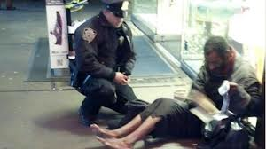
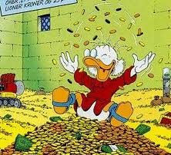
Rough proportions
Egoists 20%
Sympathetic Consequentialists 45%
Impact philanthropists (Be the one) 10%
Deontologists (Do the right thing) 10%

Slide 32
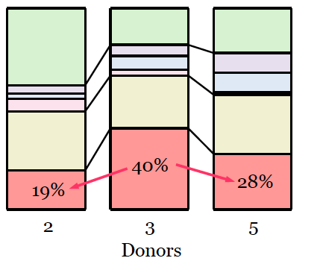
No donation in first round of experiments

Slide 33
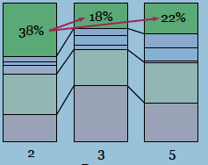
First moment in first round of experiments

Slide 34
Miscellaneous results about Volunteers’ dilemma

Slide 35
Uncoordinated Volunteers’ Dilemma
With incomplete information and varying preferences, adding more people may either increase or decrease probability that nobody is helped, depending on shape of the distribution function of cost benefit ratios.
Bergstrom 2012

Slide 36
Ethics and The Duplication Problem
An efficient symmetric equilibrium does not have everyone taking action, but has identical mixed strategies.
-In limit as n gets large, probability that any individual helps approaches zero, but probability that somebody helps approaches 1.
Bergstrom, November 2012. “Ethics and the Volunteers’ Dilemma

Slide 37
Further defense of New Yorkers
Less interesting for theory, but facts deserve respect.
Fact-checkers later found the journalists’ story partly fabricated (albeit by NYC-based journalists).
No evidence that 38 people knew what was going on. It was 3 am on a cold night. Windows were closed. A couple of people did try to help.

