Slide 1
Hal’s Ann Arbor Days

Slide 2
Economics Building, ca 1976

Slide 3
Econ Before Hal

Slide 4
The Magician arrives

Slide 5
Econ With Hal

Slide 6
They flocked to hear him lecture

Slide 7
Hal’s T.A explains supply and demand

Slide 8
Ann Arbor Celebration

Slide 9
Where is Waldo? (1978)

Slide 10
Where was Waldo in 1976?

Slide 11
Hal’s Burns Park Abode

Slide 12
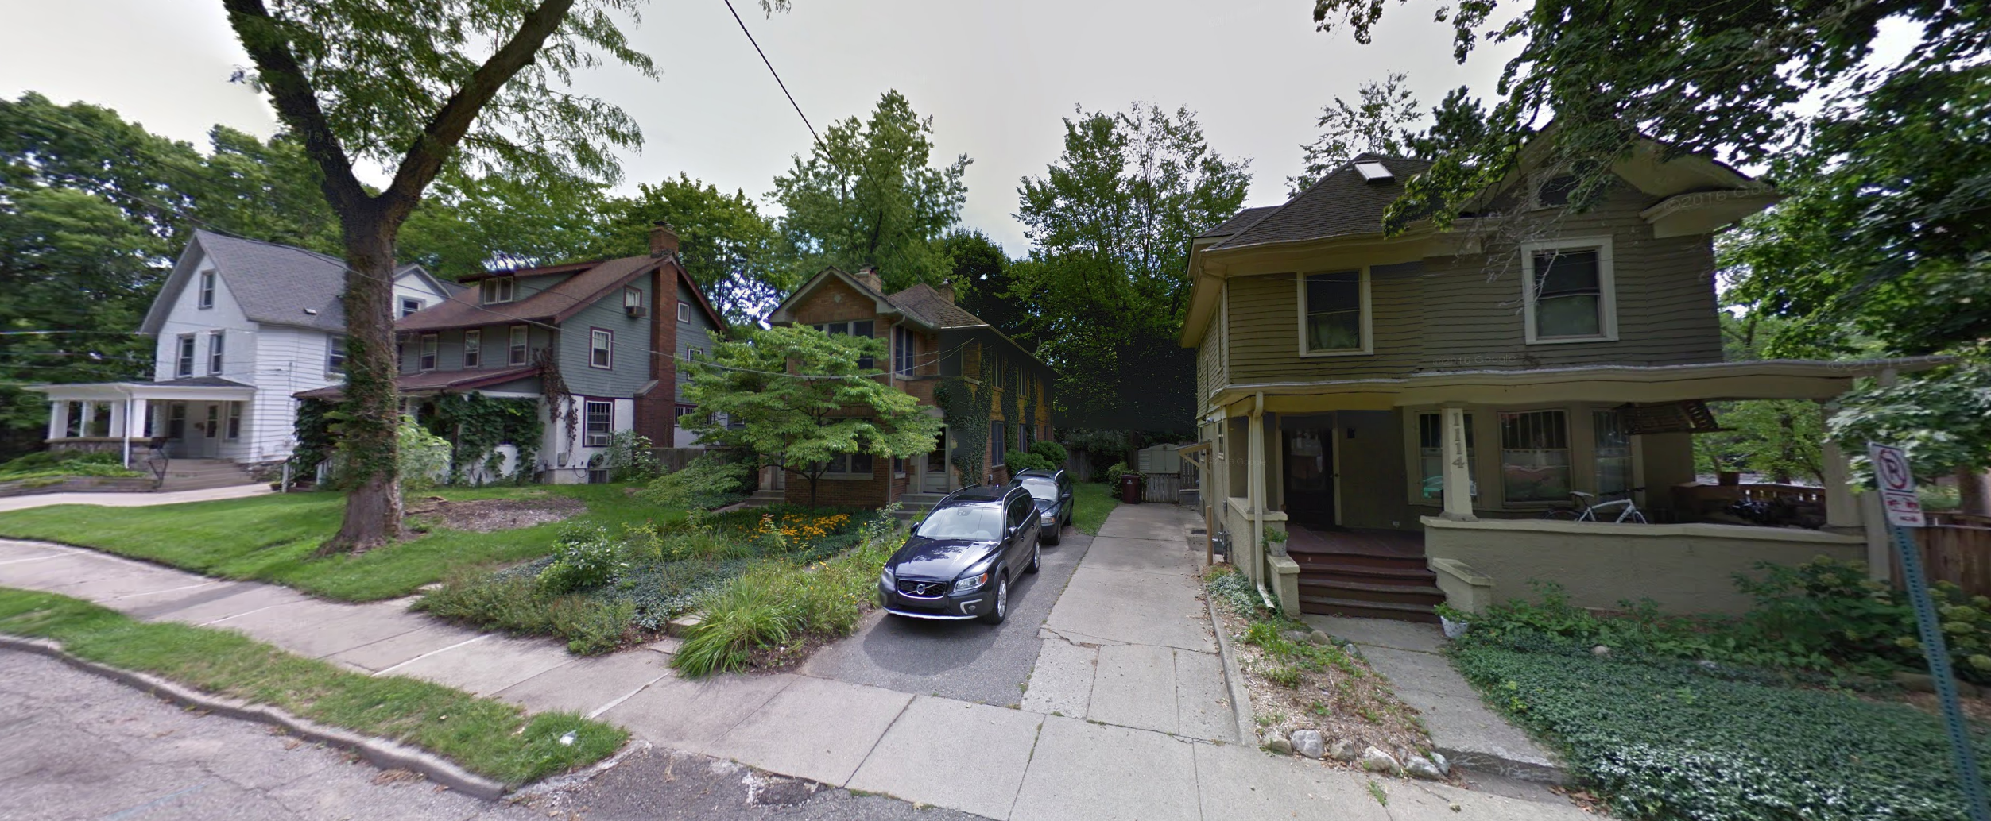

Slide 14
Hal tells all

Slide 15
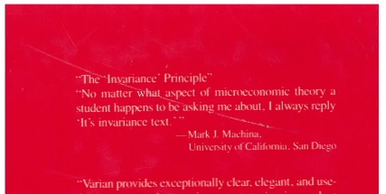
Machina’s invariance principle

Slide 16
New Zealand version
Whenever a graduate student comes to me with a question about economic theory, I tell him to:
Go to Hal!
Alan Woodfield

Slide 17
Econ for all

Slide 18
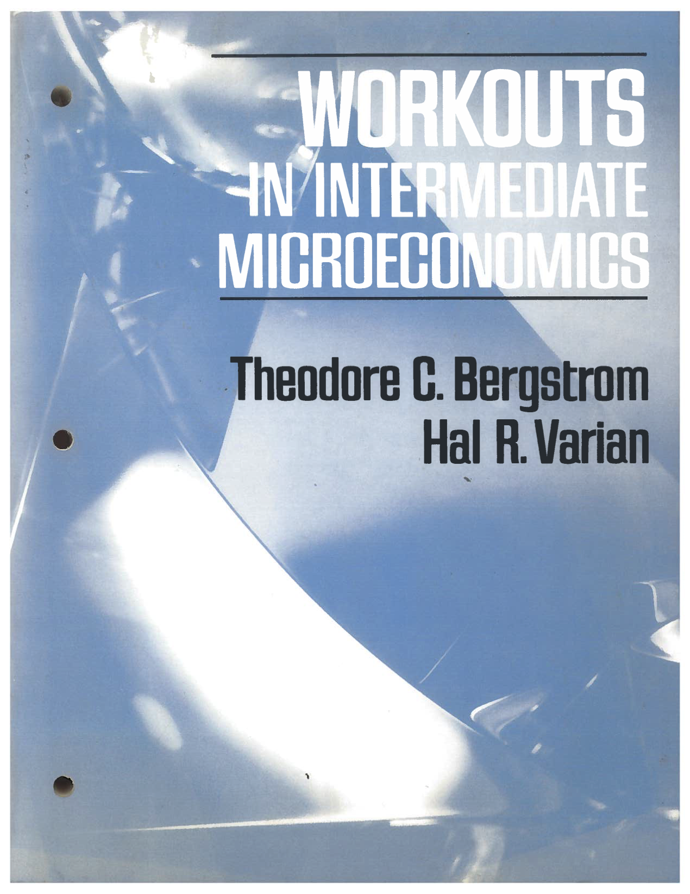
Compendium of Sophomoric Jokes

Slide 19
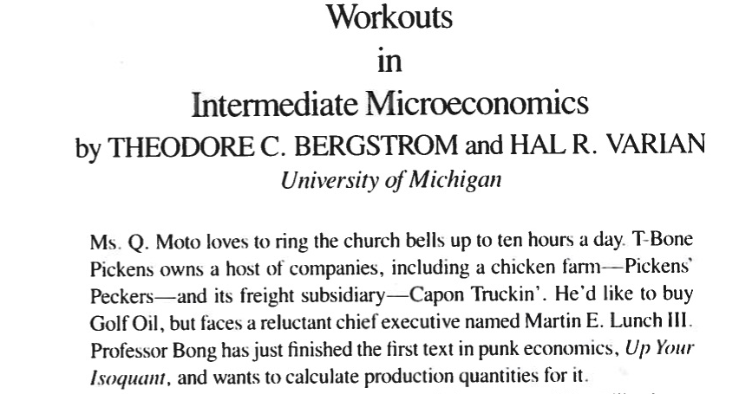

Slide 20
The League: Home of the Econ Round Table

Slide 21
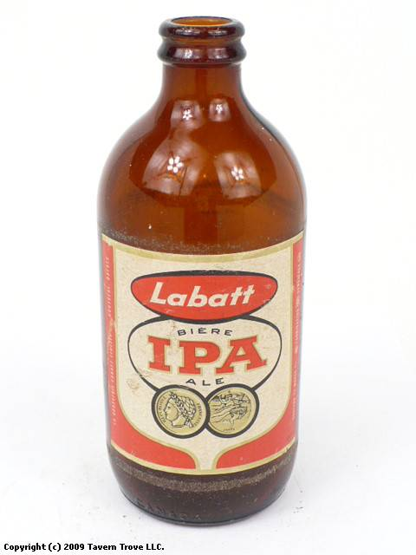
Annual Stroh’s Labatt’s Economic Theory Conference Michigan—Western Ontario

Slide 22
Christmas Eve, 1980

Slide 23
The Ruins

Slide 24
Christmas Morn

Slide 25
Post-Fire Exile: 1981-86

Slide 26
Hal meets TeX

Slide 27
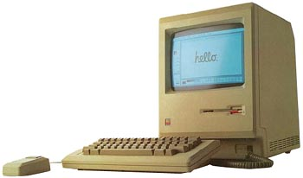
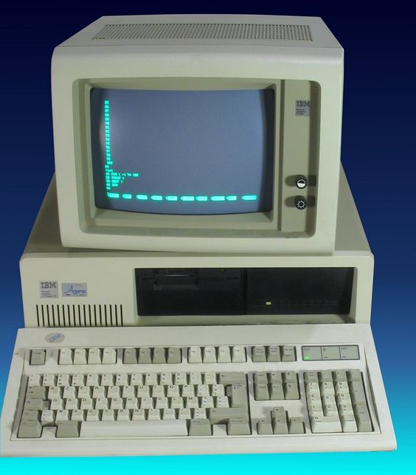
New Toys

Slide 28
What’s next?

Slide 29
Hal Moves to the Better Homes and Gardens Neighborhood

Slide 30
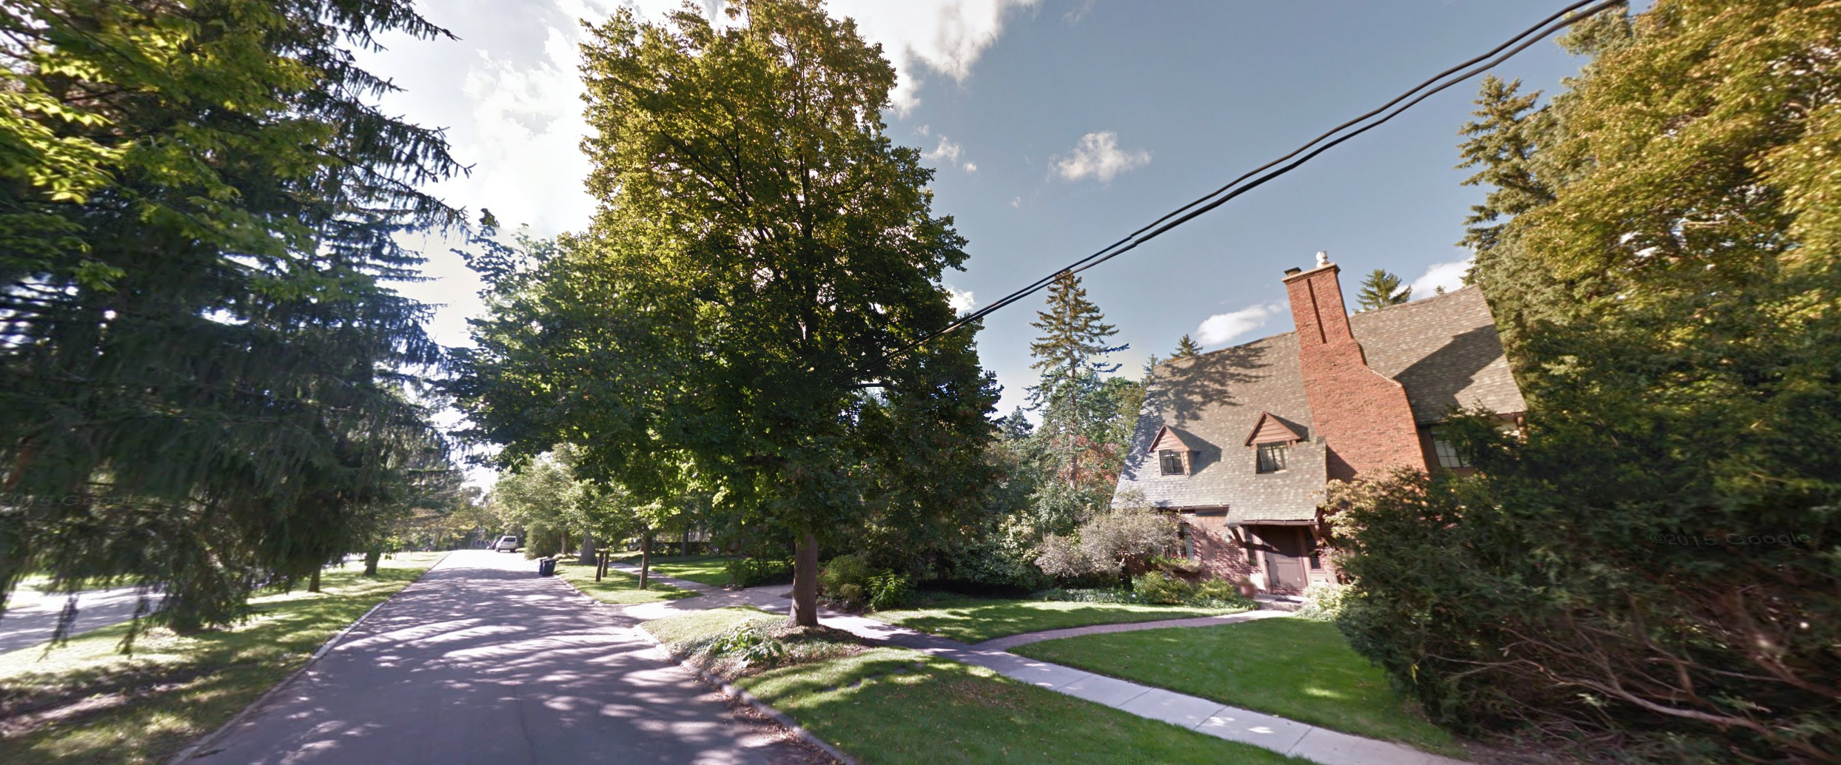

Slide 31
Econ Department Leaves Hospital, Returns to Campus, 1986

Slide 32
Lorch Hall: Return from Babylon

Slide 33
Dominick’s

Slide 34
Back in those days,

Slide 35
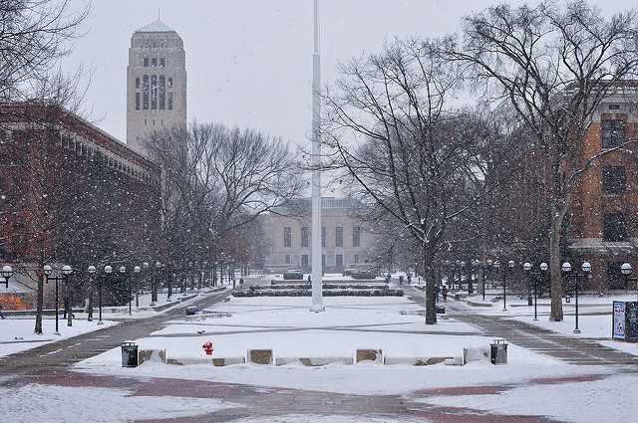
We sure had
We sure had a Hal of a lot of fun!

Slide 36
a Hal of a lot

Slide 37
of fun!
Happy Birthday!

